Slide 1

1
CHAPTER
What Is Economics?

Slide 2
After studying this chapter you will be able to
Define economics and distinguish between microeconomics and macroeconomics
Explain the two big questions of economics
Explain the key ideas that define the economic way of thinking
Explain how economists go about their work as social scientists

Slide 3
Understanding Our Changing World
  You are studying economics at a time of enormous change.
  Much of the change is for the better—the information age and all the benefits that it brings.
  But some of the change is for the worse—terrorism, natural disasters, and recession that have devastated many of our lives.
  Your economics course will help you to understand the powerful forces that are shaping and changing our world.

Slide 4
Definition of Economics
  All economic questions arise because we want more than we can get.
  Our inability to satisfy all our wants is called scarcity.
  Because we face scarcity, we must make choices.
  The choices we make depend on the incentives we face.
  An incentive is a reward that encourages an action or a penalty that discourages an action.

Slide 5
Definition of Economics
  Economics is the social science that studies the choices that individuals, businesses, governments, and entire societies make as they cope with scarcity and the incentives that influence and reconcile those choices.

Slide 6
Definition of Economics
Microeconomics
  Microeconomics is the study of choices that individuals and businesses make, the way those choices interact in markets, and the influence of governments.
Macroeconomics
  Macroeconomics is the study of the performance of the national and global economies.

Slide 7
Two Big Economic Questions
  Two big questions summarize the scope of economics:
  How do choices end up determining what, how, and for whom goods and services get produced?
  When do choices made in the pursuit of self-interest also promote the social interest?

Slide 8
Two Big Economic Questions
What, How, and For Whom?
  Goods and services are the objects that people value and produce to satisfy human wants.
What?
  What we produce changes over time.
  Seventy years ago, almost 25 percent of Americans worked on farms. Today that number is 3 percent.
  Seventy years ago, 45 percent of Americans produced services. Today, almost 80 percent of Americans have service jobs.

Slide 9
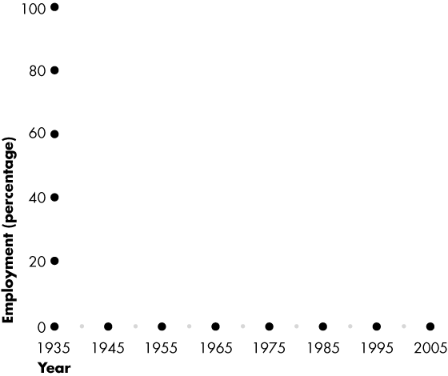
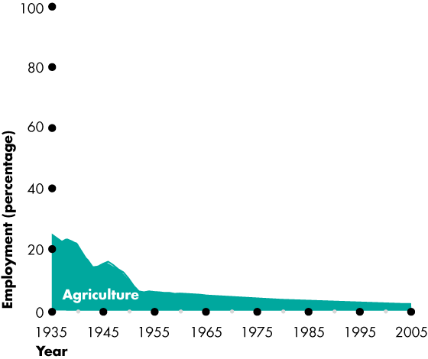
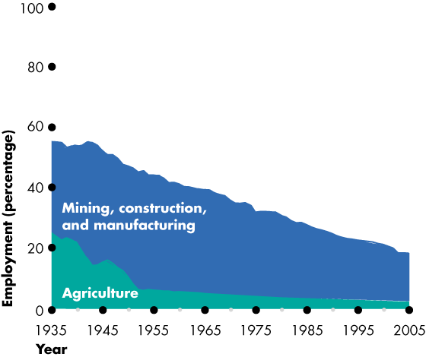
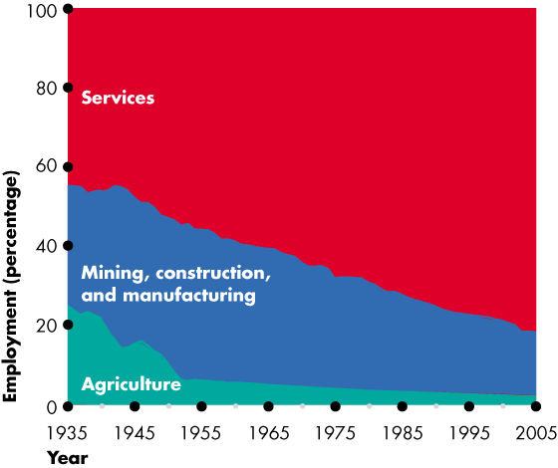
Two Big Economic Questions
  Figure 1.1 shows the trends in what the U.S. economy has produced over the past 70 years.
  It shows the decline of employment in agriculture and in mining, construction, and manufacturing, and the expansion in services.
  Economics explains these trends.

Slide 10
Two Big Economic Questions
How?
  Goods and services are produced by using productive resources that economists call factors of production.
  Factors of production are grouped into four categories:
  Land
  Labor
  Capital
  Entrepreneurship

Slide 11
Two Big Economic Questions
  The “gifts of nature” that we use to produce goods and services are land.
  The work time and work effort that people devote to producing goods and services is labor.
  The quality of labor depends on human capital, which is the knowledge and skill that people obtain from education, on-the-job training, and work experience.
  The tools, instruments, machines, buildings, and other constructions that are used to produce goods and services are capital.
  The human resource that organizes land, labor, and capital is entrepreneurship.

Slide 12
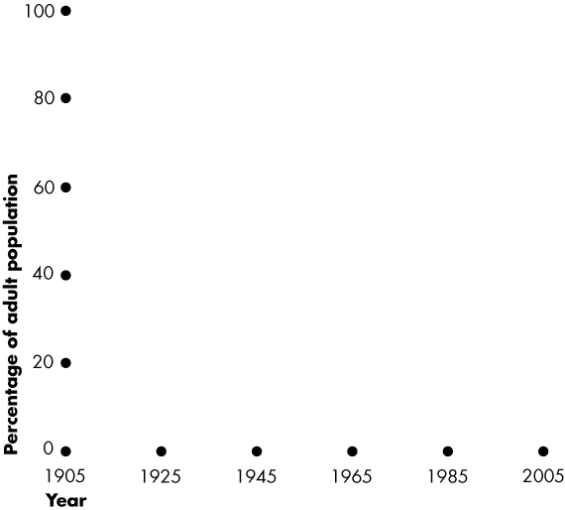
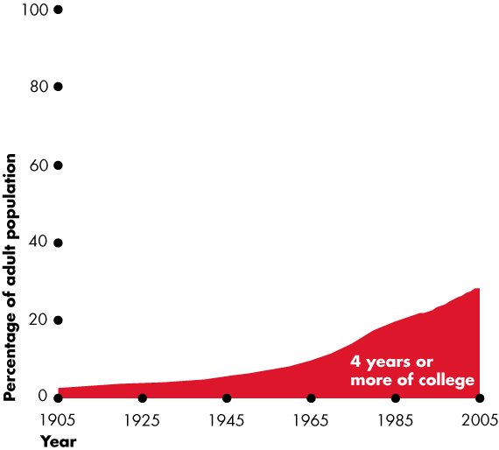
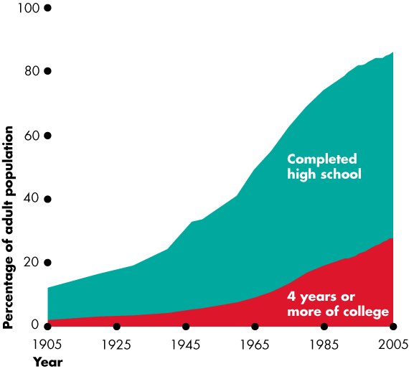
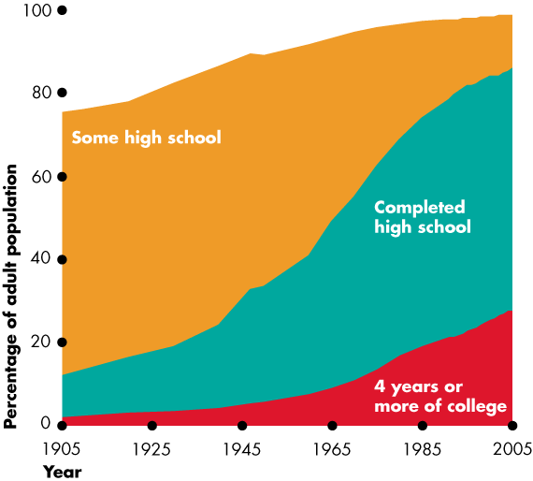
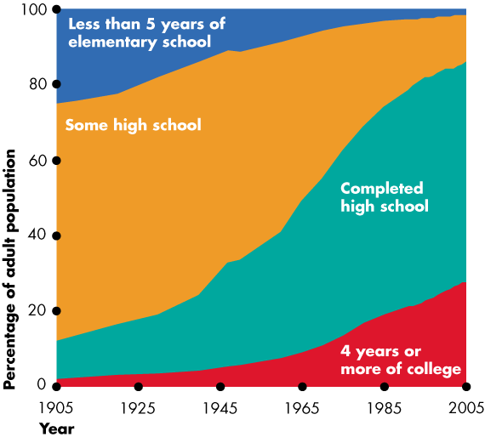
Two Big Economic Questions
  Figure 1.2 shows a measure of the growth of human capital in the United States over the last century—the percentage of the population that has completed different levels of education.
  Economics explains these trends.

Slide 13
Two Big Economic Questions
For Whom?
  Who gets the goods and services depends on the incomes that people earn.
  Land earns rent.
  Labor earns wages.
  Capital earns interest.
  Entrepreneurship earns profit.

Slide 14
Two Big Economic Questions
When Is the Pursuit of Self-Interest in the Social Interest?
  Every day, 6.6 billion people make economic choices that result in What, How, and For Whom goods and services get produced.
  Do we produce the right things in the right quantities?
  Do we use our factors of production in the best way?
  Do the goods and services go to those who benefit most from them?

Slide 15
Two Big Economic Questions
  You make choices that are in your self-interest—choices that you think are best for you.
  Choices that are best for society as a whole are said to be in the social interest.
  Is it possible that when each one of us makes choices that are in our self-interest, it also turns out that these choices are also in the social interest?

Slide 16
Two Big Economic Questions
  Ten issues in today’s world illustrate the importance of this question:
  Does public ownership and central planning do a better job than private business and free markets?
  Is globalization a benefit or a problem?
  Do the technological advances in the “new economy” bring benefits to all?
  How did 9/11 change our economic lives?

Slide 17
Two Big Economic Questions
  Don’t corporate scandals show that big business works against the social interest?
  Should drug companies be forced to make HIV/AIDS drugs available to poor people at a low cost?
  Are we destroying our tropical rainforests?
  Are the world’s water resources being managed properly?
  Are there enough jobs?
  Are we all (individuals, businesses, and governments) borrowing too much and creating too much debt?

Slide 18
The Economic Way of Thinking
Choices and Tradeoffs
  The economic way of thinking places scarcity and its implication, choice, at center stage.
  You can think about every choice as a tradeoff—an exchange—giving up one thing to get something else.
  The classic tradeoff is “guns versus butter.”
  “Guns” and “butter” stand for any two objects of value.

Slide 19
The Economic Way of Thinking
What, How, and For Whom Tradeoffs
  The questions what, how, and for whom become sharper when we think in terms of tradeoffs.
  What Tradeoffs arise when people choose how to spend their incomes, when governments choose how to spend their tax revenues, and when businesses choose what to produce.

Slide 20
The Economic Way of Thinking
  How Tradeoffs arise when businesses choose among alternative production technologies.
  For Whom Tradeoffs arise when choices change the distribution of buying power across individuals.
  Government redistribution of income from the rich to the poor creates the big tradeoff—the tradeoff between equality and efficiency.

Slide 21
The Economic Way of Thinking
Choices Bring Change
  What, how, and for whom goods and services get produced changes over time and the quality of our economic lives improve.
  But the quality of our economic lives and the rate at which they improve depends on choices that involve tradeoffs.
  We face three tradeoffs between enjoying current consumption and leisure time and increasing future production, consumption, and leisure time.

Slide 22
The Economic Way of Thinking
  If we save more, we can buy more capital and increase our production.
  If we take less leisure time, we can educate and train ourselves to become more productive.
  If businesses produce less and devote resources to research and developing new technologies, they can produce more in the future.
  The choices we make in the face of these tradeoffs determine the pace at which our economic condition improves.

Slide 23
The Economic Way of Thinking
Opportunity Cost
  Thinking about a choice as a tradeoff emphasizes cost as an opportunity forgone.
  The highest-valued alternative that we give up to get something is the opportunity cost of the activity chosen.

Slide 24
The Economic Way of Thinking
Choosing at the Margin
  People make choices at the margin, which means that they evaluate the consequences of making incremental changes in the use of their resources.
  The benefit from pursuing an incremental increase in an activity is its marginal benefit.
  The opportunity cost of pursuing an incremental increase in an activity is its marginal cost.

Slide 25
The Economic Way of Thinking
Responding to Incentives
  Our choices respond to incentives.
  For any activity, if marginal benefit exceeds marginal cost, people have an incentive to do more of that activity.
  If marginal cost exceeds marginal benefit, people have an incentive to do less of that activity.
  Incentives are also the key to reconciling self-interest and the social interest.

Slide 26
The Economic Way of Thinking
Human Nature, Incentives, and Institutions
  Economists take human nature as given and view people as acting in their self-interest.
  Self-interested actions are not necessarily selfish actions.
  But if human nature is given and people pursue self-interest, how can the social interest be served?
  Economists answer this question by emphasizing the role of institutions in creating incentives to behave in the social interest.
  Paramount: the rule of law that protects private property and facilitates voluntary exchange in markets.

Slide 27
Economics: A Social Science
  Economics is a social science.
  Economists distinguish between two types of statement:
    What is—positive statements
    What ought to be—normative statements
  A positive statement can be tested by checking it against facts.
  A normative statement cannot be tested.

Slide 28
Economics: A Social Science
  The task of economic science is to discover positive statements that are consistent with what we observe in the world and that enable us to understand how the economic world works.
  This task is large and breaks into three steps:
    Observation and measurement
    Model building
    Testing models

Slide 29
Economics: A Social Science
Observation and Measurement
  Economists observe and measure economic activity, keeping track of such things as:
    Quantities of resources available
    Wages and work hours
    Quantities of goods and services produced
    Prices of goods and services consumed
    Taxes and government spending
    Quantities of goods and services bought from and sold to other countries.

Slide 30
Economics: A Social Science
Model Building
  An economic model is a description of some aspect of the economic world that includes only those features of the world that are needed for the purpose at hand.

Slide 31
Economics: A Social Science
Testing Models
  An economic theory is a generalization that summarizes what we think we understand about the economic choices that people make and the performance of industries and entire economies.
  A theory is a bridge between a model and reality. It is a proposition about which model works.

Slide 32
Economics: A Social Science
Obstacles and Pitfalls in Economics
  Economists cannot easily do experiments and most economic behavior has many simultaneous causes.
  To isolate the factor of interest, economists use the logical device called ceteris Paribus or “other things being equal.”
  Economists try to isolate cause-and-effect relationship by changing only one variable at a time, holding all other relevant factors unchanged.

Slide 33
Economics: A Social Science
Obstacles and Pitfalls in Economics
  Economists try to avoid two common fallacies:
  Fallacy of Composition A false statement that says what is true of the parts is true of the whole or what is true of the whole is true of the parts.
  Post Hoc Fallacy From the Latin term “Post hoc, ergo propter hoc”, which means “after this, therefore because of this.” The error of reasoning that a first event causes a second event because the first occurs before the second.

Slide 34
Economics: A Social Science
Agreement and Disagreement
  Economists are often accused of contradicting each other.
  In contrast to the popular image, economists find much common ground on a wide range of issues.
  Page 14 of the textbook lists twelve economic propositions that at least 70 percent of all economists polled agreed on.

Slide 35

THE END

